Slide 1
SAE Aero Design Challenge 2021
Team Pegasus Alpha
BITS Pilani K.K. Birla Goa Campus
ADC20210118
Notes:
Good Afternoon, This is the Technical Presentation from Team Pegasus Alpha from BITS Pilani Goa Campus, for SAE ADC 2021.

Slide 2
Aircraft Design Characteristics, Summarised
Notes:
To start off, let’s summarise the basic characteristics and performance parameters of the aircraft, and lay the foundation for the innovative design we have implemented.

Slide 3
Characteristic | Design Choice
Aircraft Type | Rectangular Wing Tractor Configuration
Base Airfoil (Wing) | FX - 63 110
Base Airfoil (Tail) | NACA 63010
Empty Weight of Aircraft (With Electronics) | 731 grams
Innovation in Design | Morphing Wing
Wing Dimensions | Span = 1000 mm; Chord = 140 mm; Area = 140,000 mm²
Tail Dimensions (Horizontal) | Span = 280 mm; Chord = 100 mm
Tail Dimensions (Vertical) | Span = 120 mm; Chord = 100 mm
Tail Lever Arm | 660 mm
Notes:
Our aircraft is a tractor with a rectangular wing incorporating the FX 63 110 airfoils, and a tail incorporating the NACA 63010 airfoil. Dimensions are mentioned for your reference. Using some innovative techniques and optimization, we could bring down the empty weight of our aircraft to 731 grams.

Slide 4
A Dual-Purpose Aircraft
Fly over disaster-affected areas for extended periods of time
Endurance Mode
Low drag and low lift setup
To carry only the most necessary components: A camera and communication equipment, to search for people and animals needing rescue
Optimized for maximum endurance
Dart towards a victim awaiting relief
High-Payload Mode
High lift setup
Can carry a heavy relief package to a victim of a disaster without delay
Optimized for improved lift and maximum efficiency possible with the payload
Does not need operating speed and angle of attack change
Notes:
As per our application report, our aircraft shall operate in two situations: A high endurance mode to loiter and perform search operations, and a high lift mode to dart towards an affected individual to drop a heavy relief package.

Slide 5
Switch between these two modes at the press of a button!
No need to change parts! Change mode mid-flight if needed!
Morph Wing allows for the same aircraft to perform both roles, and many more, without any hassle of parts changes or delay!
Notes:
Our innovation allows for the aircraft to most efficiently perform both tasks, at merely the press of a button!

Slide 6
Max Endurance Mode (Search and Track Spec)
Max Payload Mode (Payload Drop Spec)
Characteristic | Design Choice
Loaded Net Weight | 2 kg
Morph State | 0%
Camber in Morph state | 4.36%
Expected Endurance | 180 s
Characteristic | Design Choice
Loaded Net Weight | 3 kg
Morph State | 75%
Camber in Morph state | 9.75%
Expected Endurance | 60 s
Notes:
This slide shows the lifting capacity and endurance of the aircraft in both modes. As you can see, we have increased the payload by a KG, and can even further, while keeping the endurance optimized.

Slide 7
Conceptual Design
Notes:
To ensure our aircraft is hand-launchable, we performed a takeoff analysis to determine the stall velocity for a given wing area. Throw speed is approximated as stall speed for the aircraft for this purpose.

Slide 8
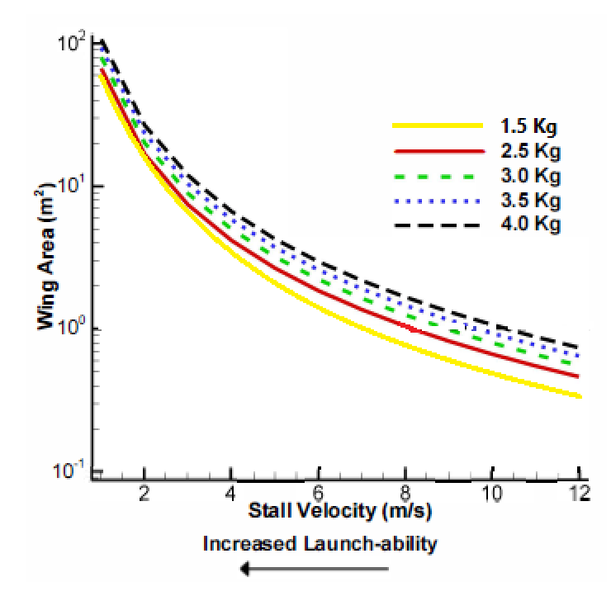
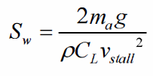
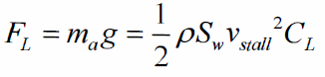
Takeoff Analysis: Hand Launchability
Hand-launchability of our UAV poses a limitation to its mass and dimensions.
It also determines the stall velocity for a particular mass since there is a maximum velocity with which we can throw the aircraft.
Using data from our previous aircraft and considering the maximum 3kg takeoff weight configuration, we get an estimate for the stall velocity to be around 12.5 ms⁻¹.
Notes:
We get the following graph between the wing area and stall velocity. Using the data from aircraft of previous competitions, we identified the stall velocity to be 12.5 ms⁻¹ for our 3kg payload configuration.

Slide 9
Overview
Airfoil Selection
Wing Sizing and Design
Battery, Empty and Max Takeoff Weight
Weight Estimation
Vertical and Horizontal Tail Sizing
Input Parameters (CD₀, K)
Aircraft Aerodynamic and Stability Design
Wing and Power Loading
Wing Area and Power Required
Control Surface Sizing
Propulsion System Design
Performance Requirement
Final Design
XFLR5 Analysis
Input Parameters Comparison
Notes:
We utilized an iterative process for our aircraft design which made use of the zero-lift coefficient and induced drag factor as input parameters.

Slide 10
Performance Requirements
Stall Speed | 12.5 m/s
C_{Lmax} | 1.45
Turn Radius | 15 m
Turning Velocity | 61.12 degrees/s
Maximum Velocity | 23 m/s
Endurance Time | 180 s
Notes:
Using these parameters we identified the

Slide 11
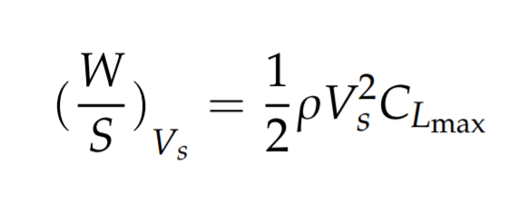
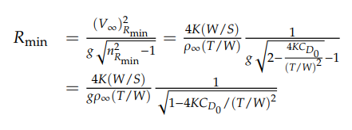
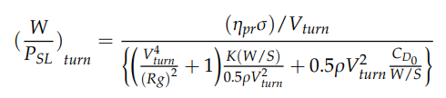
Wing and Power Loading
From the stall velocity and turning radius requirements of our UAV, we get the values:
Power loading: 0.833 N/W
Wing loading 140 N/m²
Notes:
wing and power loading from the performance requirements,

Slide 12
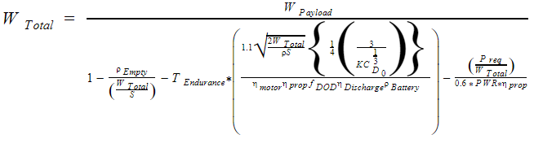
Weight Estimation (Baseline Configuration)
ρ_{Empty} | 39 N/m²
ρ_{Battery} | 140 Wh/kg
η_{motor} | 0.8
η_{Discharge} | 0.9
PWR | 3.75 kW/kg
T_{Endurance} | 180 s
f_{DOD} | 0.9
Total Takeoff Weight
2 kg
Empty Weight
546 grams
Motor Weight
90 grams
Battery Weight
125 grams
Payload Weight
1.2 kg
Notes:
estimated the weight of the aircraft, and calculated the total wing area.

Slide 13
Wing Design and Sizing

Slide 14
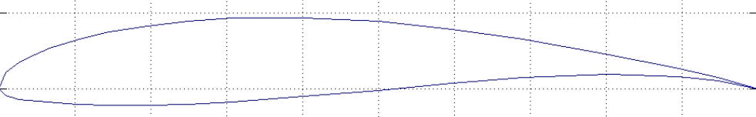
Airfoil Selection
Several airfoils were compared based on the following requirements:
A good balance of high lift and high aerodynamic efficiency
Low Critical Reynolds Number
High stall angle
Provides the necessary CL and CD requirements
The FX 63 family of airfoils met these characteristics and was considered for the design process.
The FX 63 110 proved to be the best of the family.
Notes:
After identifying a suitable wing area, we identified airfoils based on the these criteria. We identified the FX 63 110 airfoil to meet these requirements.

Slide 15
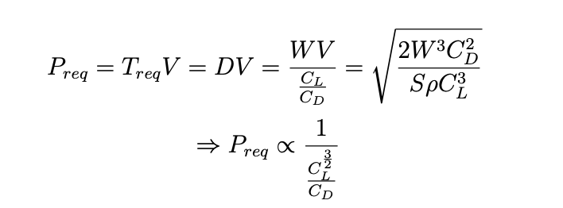
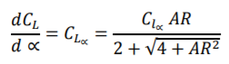
Wing Design and Sizing
A rectangular wing design was chosen.
For the baseline design,
AoA range: 3-6 degrees
Velocity: 17 m/s at 6 degrees; 14 m/s at 3 degrees
An iterative approach was used to identify the percent morph for the heavy-lift configuration and aspect ratio of the wing.
Notes:
We chose a rectangular wing design for our aircraft. Using CL^1.5/CD which is inversely related to the power consumed, we identified an operating range as shown.
Using the relation, we iterated through a range of morphing amounts to size and identify the percent morphing for our heavy-lift configuration.

Slide 16
Design Validation using XFLR5
Notes:
After laying the theoretical foundation, we calculated the input parameters using XFLR5 and compared them with the initial values. If the values match, our design process was complete, otherwise, we used the new values as the initial input parameters and repeated the process. The XFLR5 process includes

Slide 17
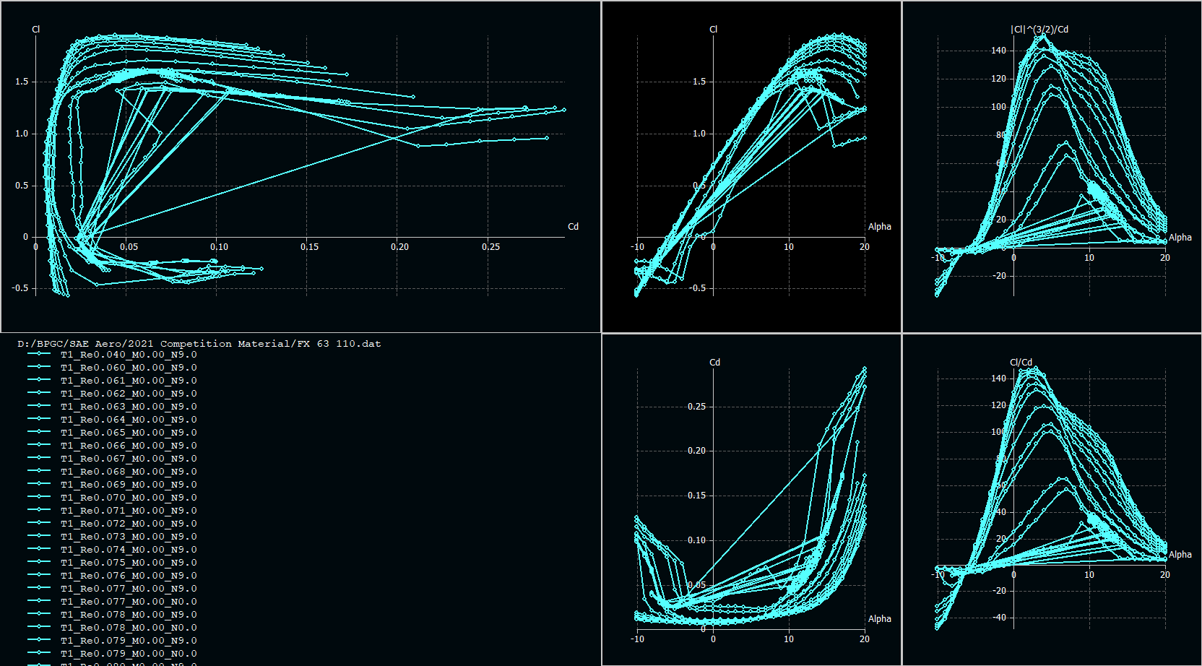
Airfoil Characteristics
For a wide range of Reynolds Numbers and Angles of Attack
Notes:
analyzing and choosing the airfoil for ideal performance at expected Reynolds number ranges,

Slide 18
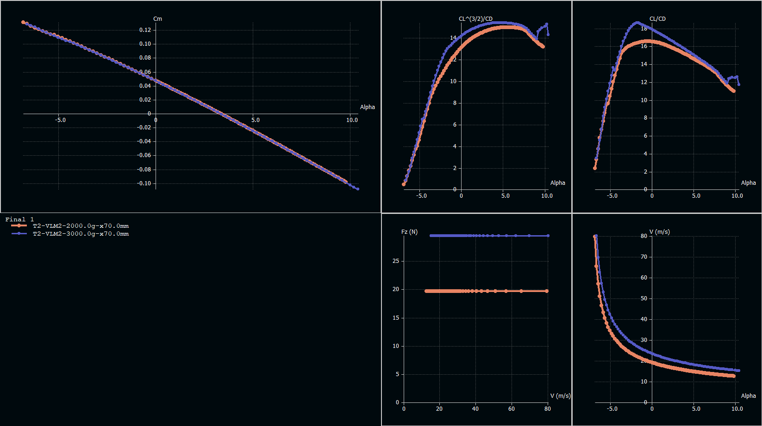
Final Wing
In Endurance and High Lift Modes
Notes:
constructing a wing and tail setup, trimming at a particular angle with a healthy static margin and power factor, all while keeping mindful of the acceptable operating angle of attack and speed. Lateral stability is ensured with a small dihedral for the wings.

Slide 19
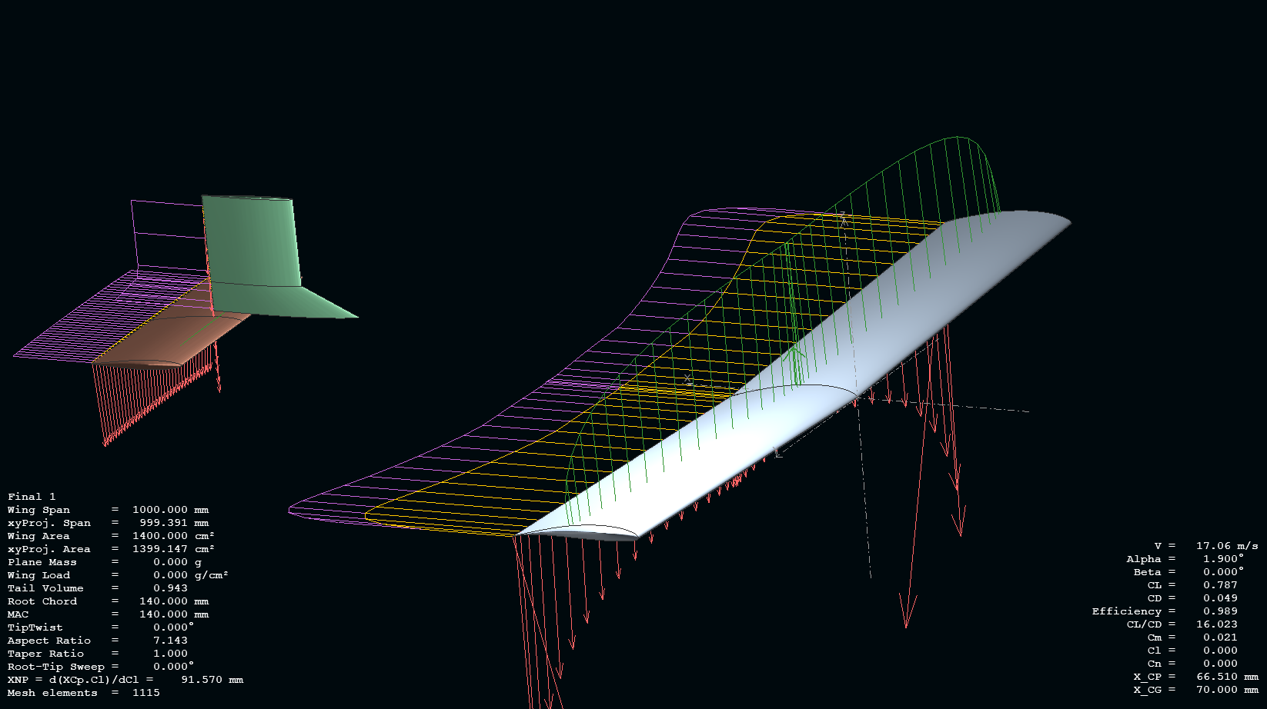
Final Wing and Tail, Endurance Mode
Notes:
These slides portray the final design for our aircraft.

Slide 20
Control Surface
Sizing and Dynamic Stability
Notes:
Using XFLR5 and analytic equations on these slides,

Slide 21
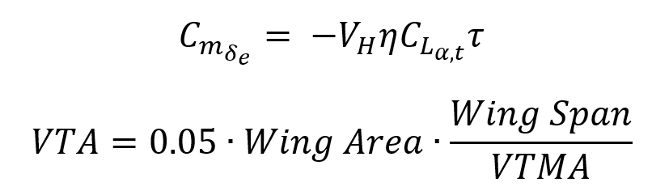
Elevator and Rudder Sizing
Rudder characteristic values
Elevator characteristic values
Sizing | 30% chord of V_{stab}
Max deflection | ±10 degrees
Elevator effectiveness | 0.218
Span | 14 cm
Chord | 25% of tail chord
Max deflection | ±10 degrees
Notes:
we can calculate the control surface sizes.

Slide 22
Dynamic Stability
Mode | Level 1 requirement | Max payload case | Stability level
Phugoid | |ζ |> 0.04 | |ζ| = 0.045 | Level 1
Short period | 0.35 < ζ < 1.3 | ζ=0.611 | Level 1
Roll | τ < 1 s | τ= 0.168 sec | Level 1
Dutch roll | ζ > 0.08 ω > 0.4 rad/s ζω > 0.15 rad/s | ζ = 0.098 ω= 2.601 rad/s ζω=0.2549 rad/s | Level 1
Spiral | Tdouble > 20 s | T_{double} = 10.413 s | Level 2
Notes:
Same goes for ensuring dynamic stability, here are the analytic results,

Slide 23
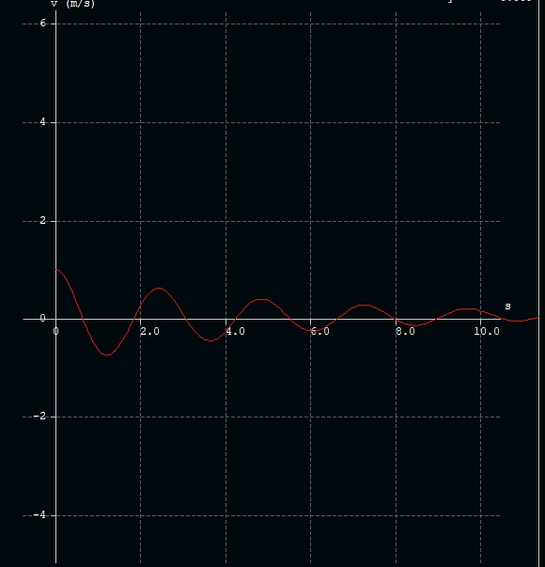
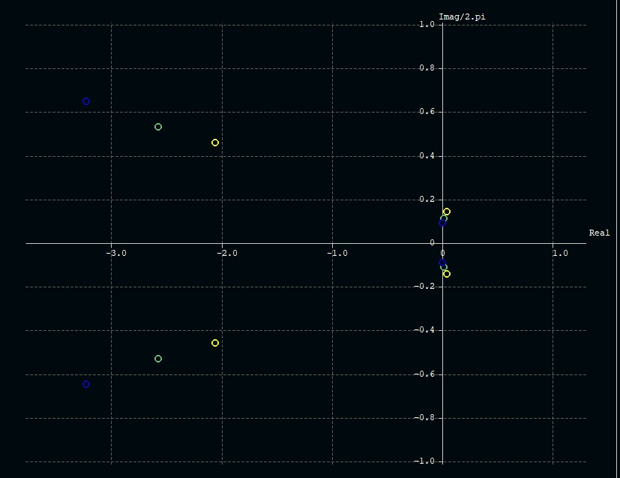
Dynamic Stability
Response to gust
Root locus graph
Notes:
Validated in XFLR5.

Slide 24
Innovation:
Morphing Wing
Notes:
Our innovation for this aircraft was inspired by the shape-shifting wings currently being developed at NASA, MIT, and FlexSys. As mentioned, our aircraft needs to operate in two scenarios with different requirements but having a basic goal of the highest endurance for the scenario. Instead of building two different wings for the purpose, we designed a morphing mechanism for a single wing that will achieve both.

Slide 25
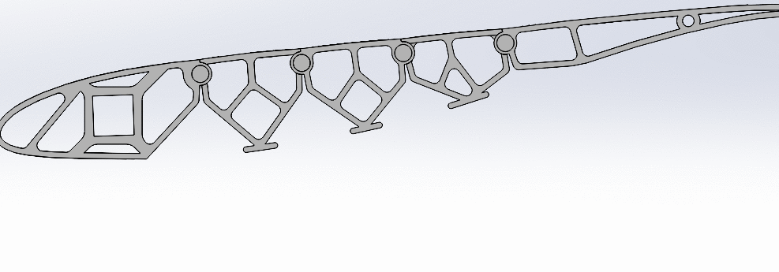
Morphing Mechanism | Airfoil
Notes:
The design is relatively simple, with the wing divided into four sections along the chord, each able to rotate to a certain angle in either direction, bound to return via torsion springs. This mechanism allows the airfoil to morph so that on full deflection, the camber of the airfoil will become nearly double the original amount when deflected downwards, and half as much when deflected upwards.

Slide 26
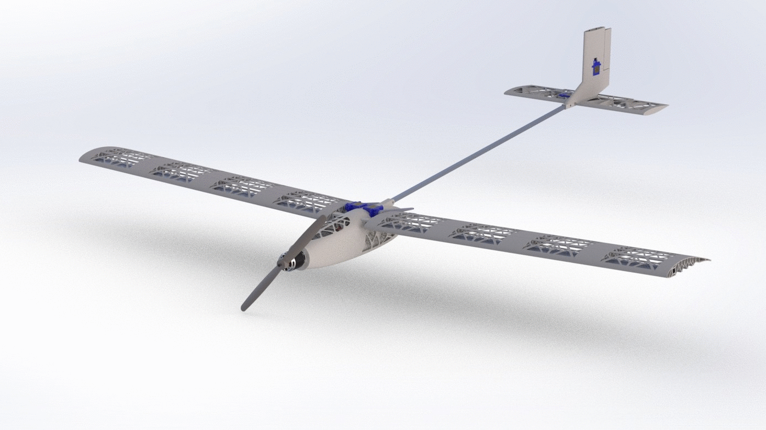
The extent of morphing of our wing
Notes:
Drag and efficiency values have been used to soft limit the deflection to 75% on either side. A servo mounted on the fuselage manipulates a control rod to perform this morph in a single arc.
This morphing capability has a litany of advantages. To sum it up, in various morph states, this aircraft can lift a wide variety of payloads without any change to its operating conditions, and be able to stall at a much lower speed and higher angle of attack. A smooth surface without discontinuities greatly reduces induced drag, as the work of flaps, ailerons and air brakes are taken up by the morphing wings as well. Maximizing endurance, however, is the goal for all of the innovations, and it is possible without changing operating conditions.

Slide 27
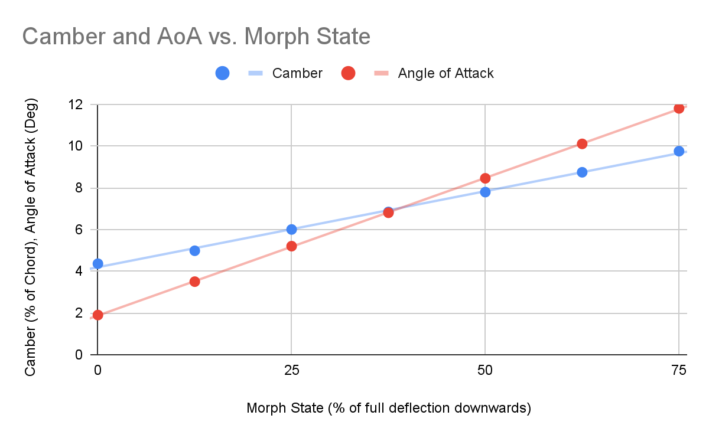
Morphing the wing changes the wing’s camber and Angle of Attack, giving a wide range of lift and endurance characteristics.
Notes:
This graph maps the camber and incidence change as morphing takes place, and there's always an ideal operating spot for any payload value without having to fly the plane faster and drain battery, let alone account for dynamic thrust requirements.

Slide 28
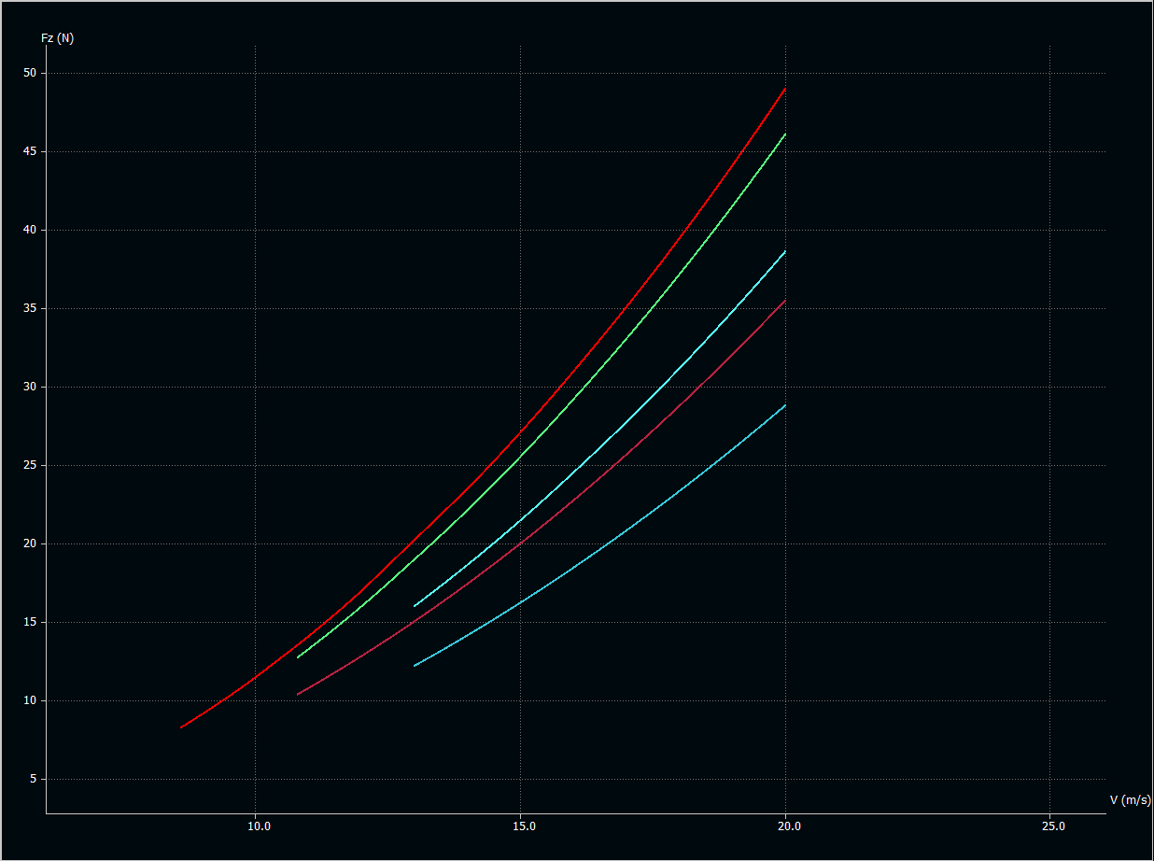
A Chart like this can help plan a mission for Maximum efficiency.
Notes:
A simple chart like this one, which shows lift against operating speed for various morph states, allows planning to an intricate level, at any speed or payload capacity, one likes or needs.

Slide 29
Electronic Components
Notes:
Since we have two modes of flight, the propeller and motor combination should be able to accommodate both of them.

Slide 30
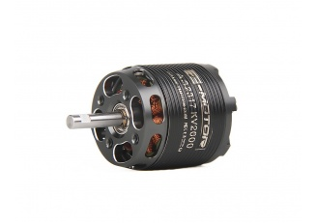
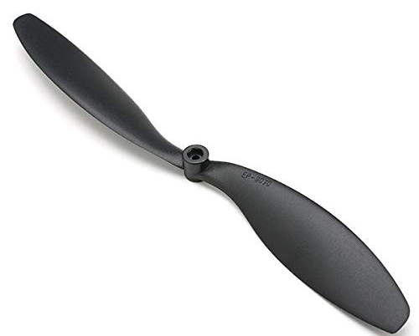
Thrust Instruments
Two different lift producing flight configurations were chosen.The first combination is supposed to be in cruise operation and the second one in liftoff with maximum payload.
AS2317 Long Shaft 1400 KV BLDC motor with a 9x7 inch propeller was selected. .
For cruising, motor operates at 75% throttle to give an RPM of 9000. For maximum liftoff configuration, the motor operates at 90% throttle to give 10500 RPM.
APC propellers are made from long carbon fibre and nylon composites.
Motor weighs 81 gm and propeller 22 gms.
Notes:
Based on our analysis, we decided upon the AS2317 Long shaft motor from T-motors and APC 9X7 inch propeller. This combination operates at 75% throttle in cruise mode and at 90% throttle for the maximum liftoff mode. The propeller is made from composites and the combination weighs at just over 100 gms.

Slide 31
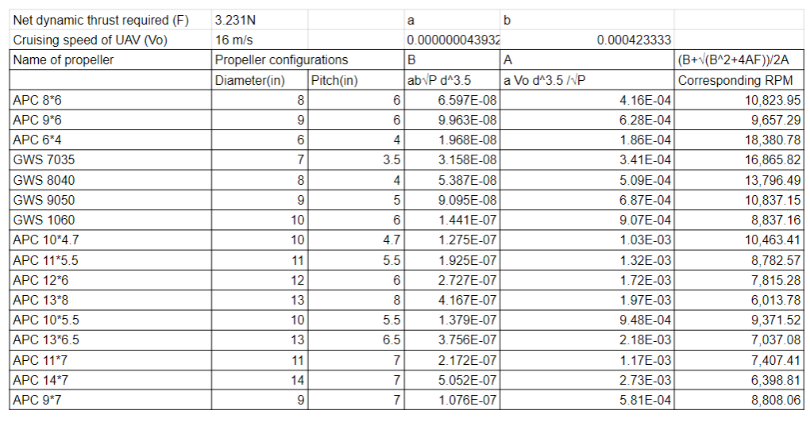
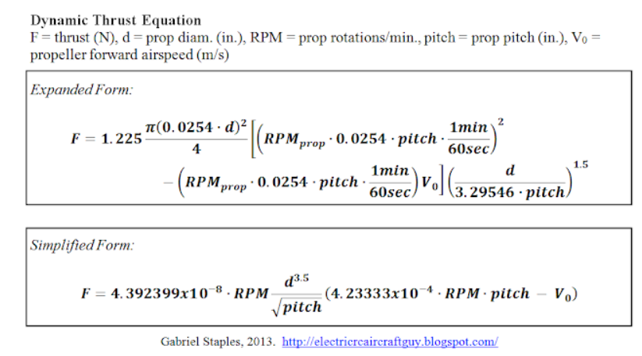
Dynamic Thrust Calculation
The dynamic thrust equation was used to get RPM for given thrust, pitch and speed.
Using data from T-motors and APC propellers website, we compared different motor-propeller combinations for our objective.
Notes:
The selection process for the motor and propeller consisted of utilizing the dynamic thrust equation to get the required RPM for given dynamic thrust and pitch and speed. By comparing desired specifications with data available on T-motors, we were able to finalize our motor propeller combination.

Slide 32
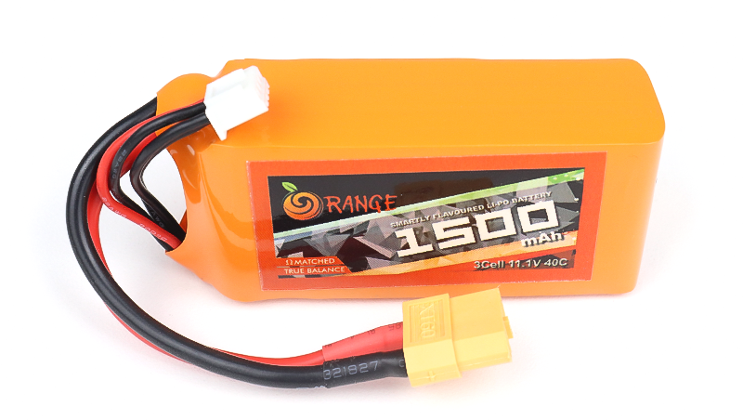
Battery
The battery used is 1500mAh 3S 40C Li-polymer battery
The battery weighs 120 gm, about 22% of the total empty weight.
It offers about 500 charge and discharge cycles at 0.5C.
Operating temperature = -10 C to 55 C
Compared to Li-Ion or other batteries, it is safer as it uses a solid electrolyte and there is no possibility of leaks.
Due to absence of metal casing, they are flexible and can handle pressures that make them resistant to breaking or burning if a crash occurs
The selected battery can provide a flight time of 180 seconds.
Notes:
For the battery, a 1500 mah Li-polymer 3 cell battery from orange was selected. The battery provides a flight time of around 3 minutes and weighs at 120 gm. To save weight, this is the smallest, and lightest battery that is sufficient for our competition attempt.

Slide 33
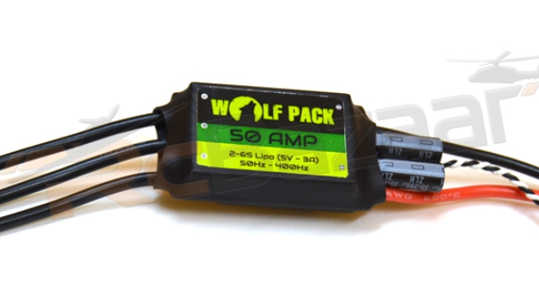

Other Onboard Electronics
The ESC used is the Wolfpack Opto 50Amp ESC
The expected maximum current to be drawn is around 40A.
Two different servos were used in the Design: Towerpro SG90 and Towerpro SG92R
The SG90 is used in the elevator and rudder of the plane as a torque of 0.016Nm is required to move the control surfaces at the desired position at cruise velocity. The SG90 can provide upto 0.117Nm.
The SG92R is used to actuate the wing morphing states of the design. The design required maximum torque of about 0.18Nm. These servos can provide 0.24Nm.
Both servos weigh at 9gms.
Notes:
A wolfpack Opto 50 A ESC well accommodates the 40 A requirement of the motor.
For servos, two models have been used; SG-90 servo for the low torque control surfaces ie. the elevator and rudder, sufficient for the maximum required 0.016 Nm; SG-92R for the high torque requirement of the morphing wing, sufficient for the required 0.18 Nm.

Slide 34
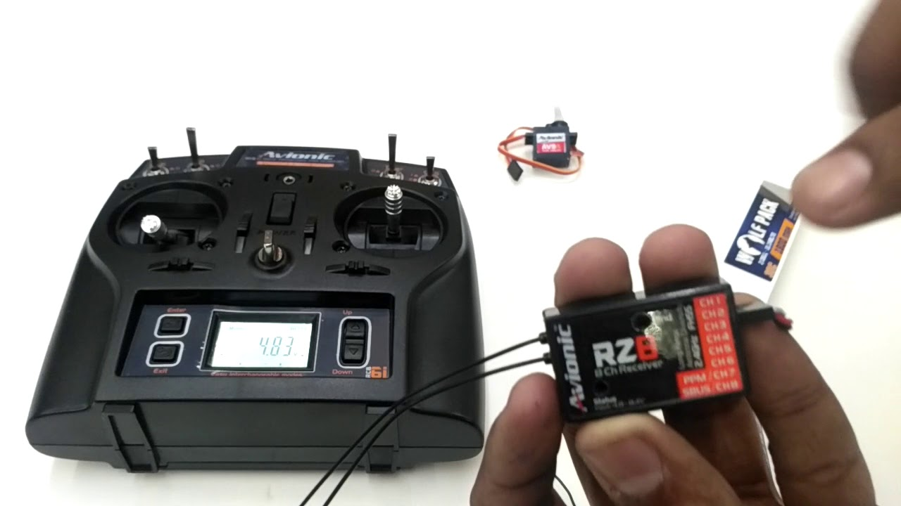
Transmitter and Receiver
A 6-channel Tx-Rx from Aviaonic is used.
4-Channels are utilized for the Aileron, elevator, thrust and rudder controls.
5th channel has 3-states and can be utilized for additions such as payload dropping.
6th channel is used to switch between 2 decided morph states.
There is a possibility to freely morph the wing, but due to limitations in availability of such tx, we used a 6-channel transmitter.
Notes:
We have used a 6-channel Tx-Rx for radio control. 4-channels used for Aileron, elevator, thrust, and rudder control, 5th channel additional features and the 6th channel to switch between two morph states. The free morphing capability of the plane was limited by the availability of suitable Tx-Rx.

Slide 35
Structural Design and Manufacturing
Notes:
The structure of the aircraft depends heavily on additive manufacturing techniques, specifically 3D printing to create complex structures.

Slide 36
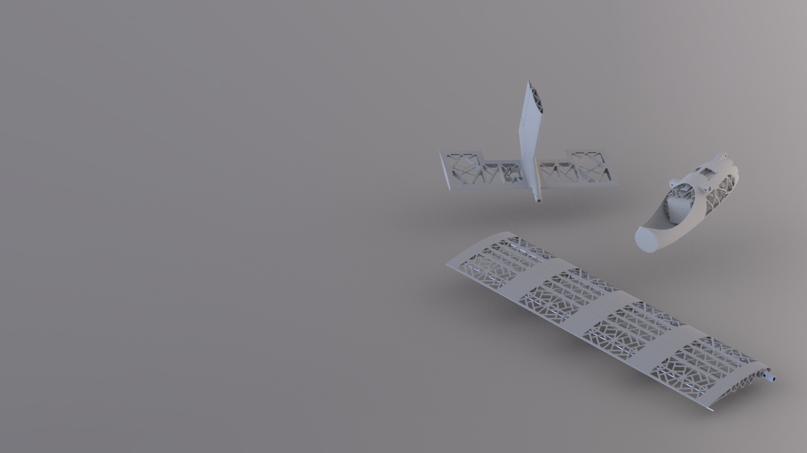
Extensive use of 3D Printing with ABS
Every part that is not available in the market is 3D printed using ABS.
The complex pieces of the wing morphing mechanism benefited from the flexibility of design additive manufacturing processes offer.
The tail and fuselage are also singular structures that supplement the strength of the materials.
Notes:
For the wing this was an obvious choice, the sections of the morphing wing were too complex to be cut out of traditional materials like balsa, and machining metals was a time and cost-consuming process. 3D printing using ABS not only is extremely lightweight (our entire aircraft comes at 731 grams) but also structurally sound.

Slide 37
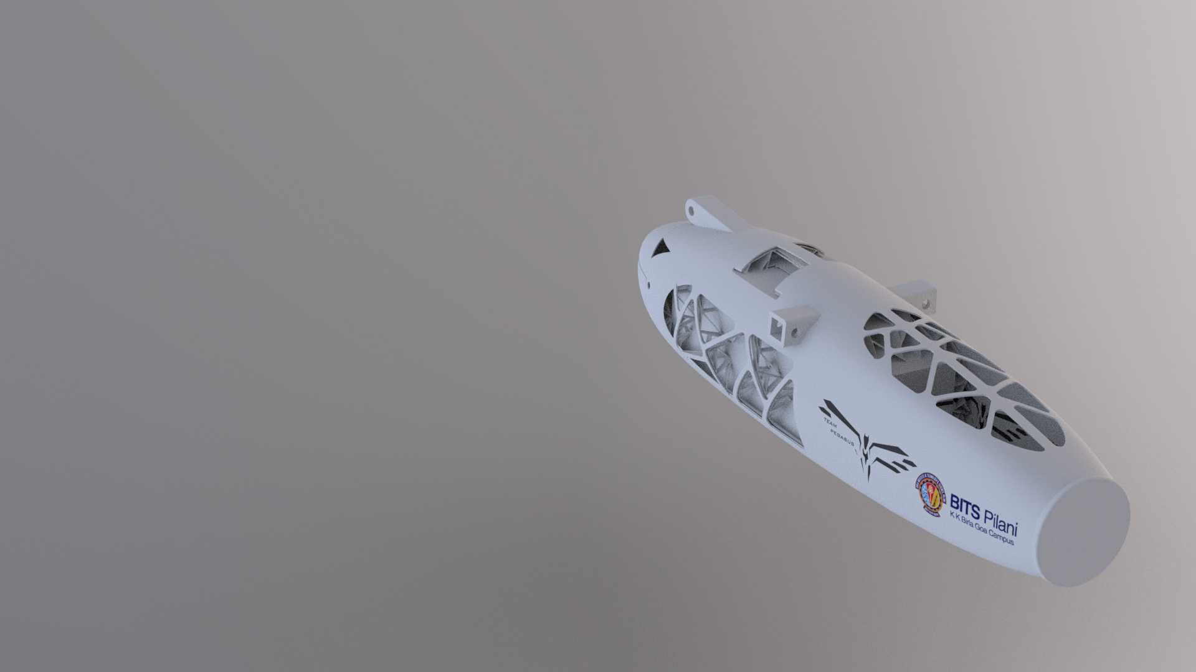
Fuselage constructed with Generative Design
Generative Design is the use of AI to make design choices for the user.
Reduced the weight of the fuselage significantly
Maintained a healthy factor of safety at all joints and lead-bearing regions
Notes:
The use of 3D printing allowed us to explore a revolutionary design process for the fuselage, called Generative Design. This process improved incredibly useful for weight optimization, while the safety factor of the structure was maintained at a healthy level. It gave our fuselage a sleek-looking aerodynamic design that is very capable of taking the payload weight, the wing lift, torque from the empennage, and miscellaneous motor forces.

Slide 38
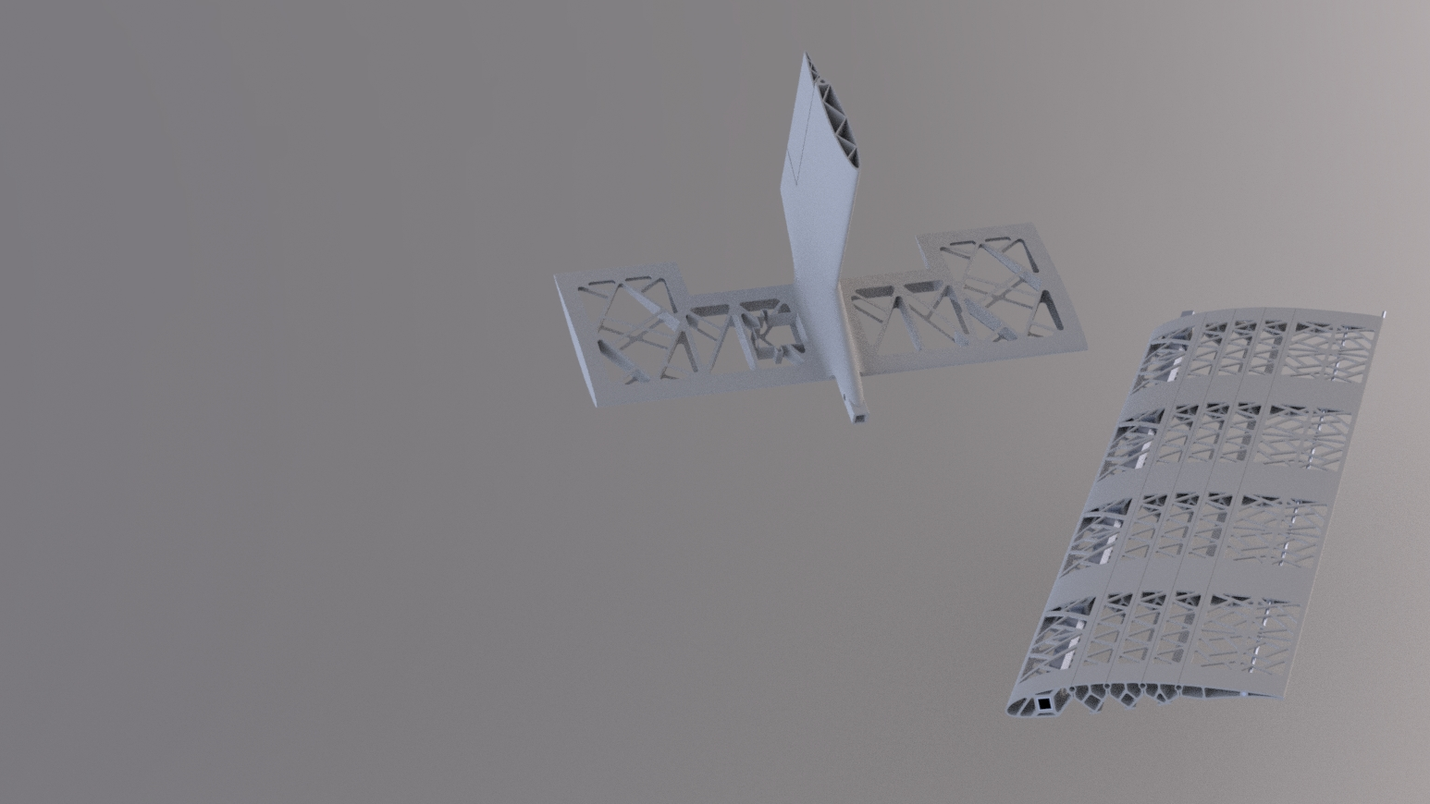
Generative Design-inspired Wing and Tail Structure
Design of Wing and tail were inspired by the fuselage.
Reinforcement is applied judiciously and unnecessary weight is shed.
The surfaces of the wing and tail are to be covered with a stretchable elastomer like Polypropylene to create a smooth wing.
Notes:
The wing and Tail structures draw design inspiration from the fuselage, allowing us to maintain component strength while shedding unnecessary weight. The surfaces are covered with stretchable plastics like Polypropylene to allow flexibility of morphing, and for a smooth surface.

Slide 39
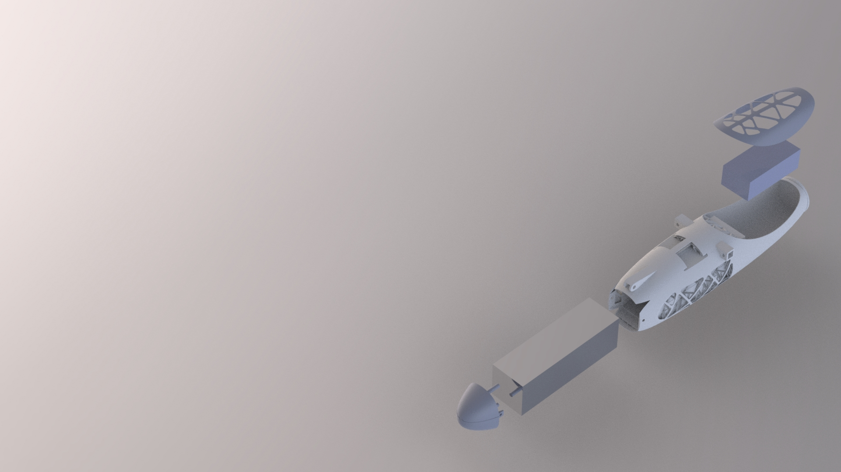
Payload Mount and Joints
Payload bay is an enclosed, tightly fit space with an opening in the aft section of the aircraft.
Payload bay and electronics hatch have screwed-on caps to secure the contents inside.
Placement is such to maintain CG at a position for an acceptable static margin, for both loaded (both payloads) and unloaded case.
Notes:
The payload bay is secure inside the fuselage as a screwed-in cap can bar the aft section of the fuselage where the payload may easily slide in and out. Similar caps are placed over the electronics bay so that they may be easily accessed.

Slide 40
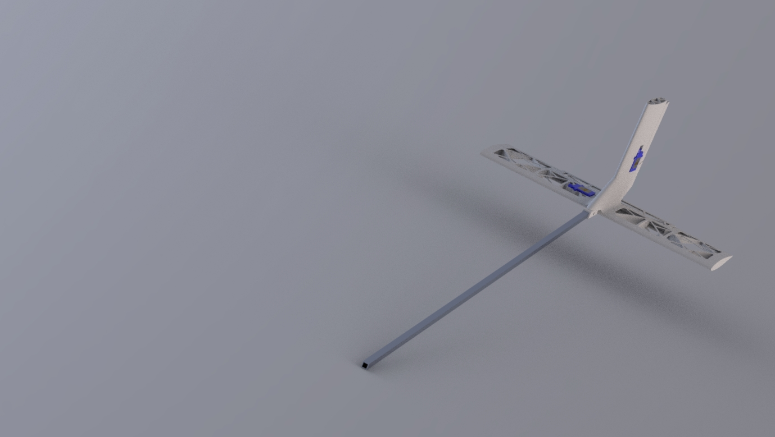
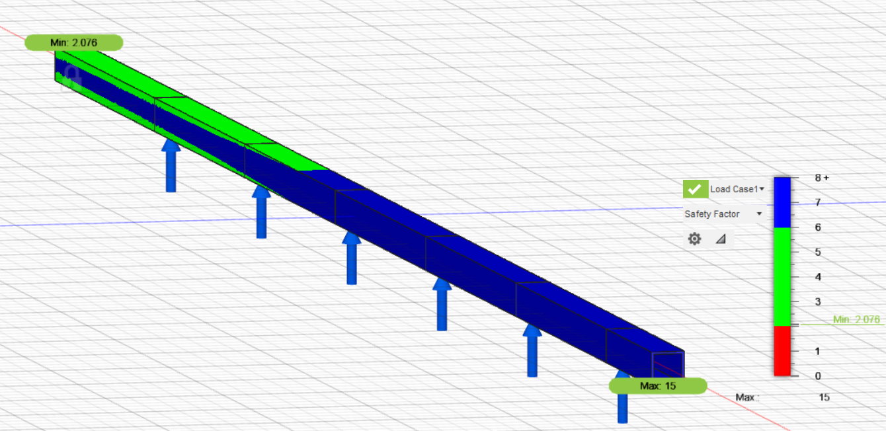
Aluminium Booms and Spars
Notes:
Aluminum is the choice of tail boom and central wing spar due to its strength to weight properties, both sized to ensure healthy safety factors. The attachments are made using 3M bolts. The major sections of the aircraft, the fuselage, 2 halves of the wing and the empennage can be separated to be stored easily in a box with the dimensions smaller than that specified for the competition.

